Slide 1

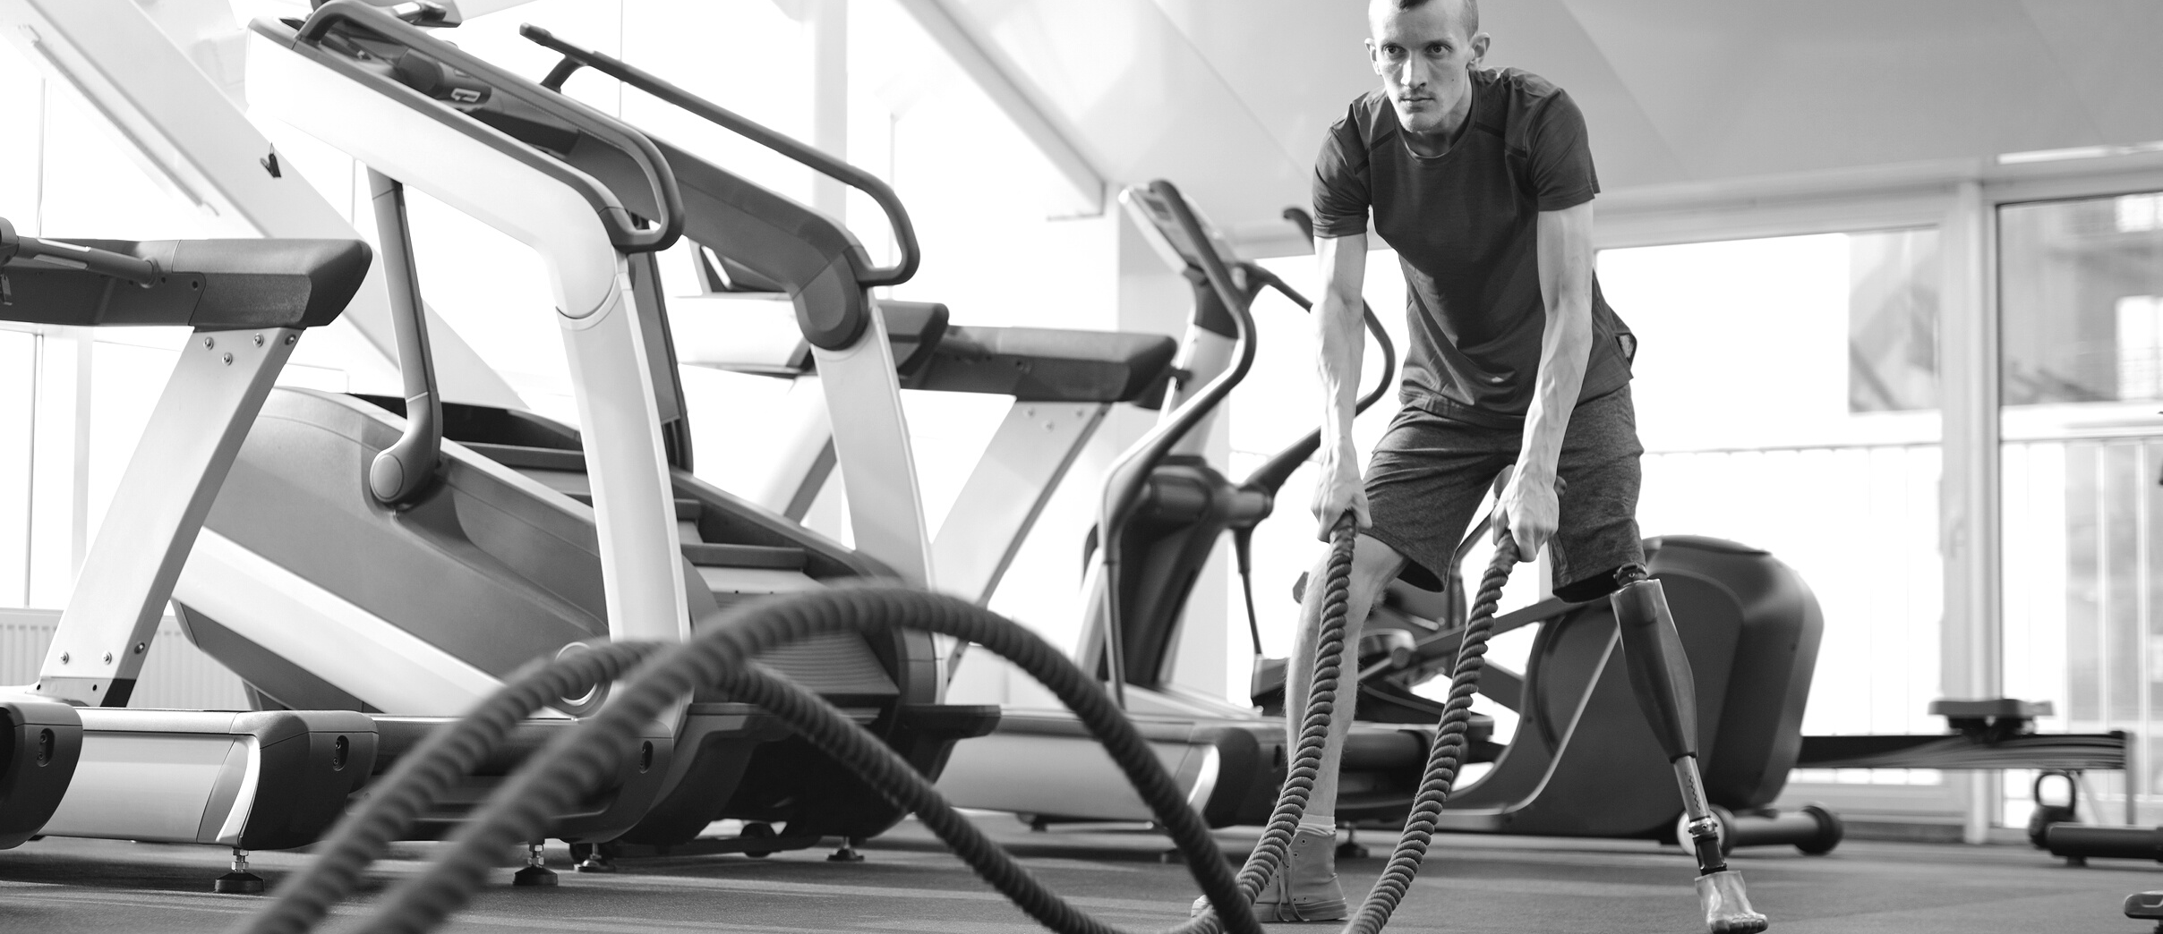


INSTRUCTOR:
PROF. SHRADDHA VYAS
DEPSTAR CE-1
F7 CLUB (FITNESS FOR 7 DAYS)
GYM AND FITNESS
GET FIT DON'T QUIT
TAKE CARE OF YOUR BODY.IT'S THE ONLY PLACE YOU LIVE
Presented By:
20DCE016 - KHUSHBU CHAUHAN
20DCE019 - YATHARTH CHAUHAN
20DCE024 - DEEP DHADUK

Slide 2


F7
AGENDA
About Us
Introduction
Objective
Project Scope
Problem System
Limitation of Existing System
Hardware and Software Specification
Flow Chart
Gantt Chart
Team Presentation

Slide 3
F7
INTRODUCTION
About Us
Objective of the Project
The main objective of the project is to design and develop a user friendly system.
Easy to use and efficient computerized system.
To develop an accurate and flexible system, it will eliminate data redundancy.
Computerization can be helpful as means of saving time & money.
To provide better graphical user interface.
Less chances of information leakage.
Provides security to data by using login & password.

Slide 4
F7
PROJECT SCOPE
About Us
The proposed system is highly secured, because for login the
system it requires the username and password which is different for
each plan.
It maintains report for all criteria and transactions.
Manages member information separately for all plan and
personal information separately
Stores information about members.
This system can run on any windows operating system.

Slide 5
F7
PROBLEM STATEMENT
About Us
The gym is working manually. The current system is time consuming because registration process. To manually handle the system was very difficult task. But now-a-days computerization made easy to work.
The following are the reasons why the current system should be computerized:
To increase efficiency with reduced cost.
To reduce the burden of paper work.
To save time management for recording details of each and every member and employee.
To generate required reports easily.

Slide 6
F7
About Us
LIMITATION OF EXISTING SYSTEM
Time consumption: As the records are to be manually maintained it consumes a lot of time.
Paper work: Lot of paper work is involved as the records are maintained in the files & registers.
Storage requirements: As files and registers are used the storage space requirement is increased.
Less reliable: Use of papers for storing valuable data information is not at all reliable.
Accuracy: As the system is in manual there are lot many chances of human errors. These can cause errors in calculating mechanism or maintaining customer details.
Difficulty in keeping new records: It is difficult for keeping all the new entries of members, their account and transaction details.

Slide 7
F7
About Us
HARDWARE AND SOFTWARE SPECIFICATION
Hardware Requirements
Processor: 1.2 Ghz or more
Ram: 1 GB or more
HardDisk: 50 GB or more
Software Requirements
Operating System: Windows XP, 7, 8, 10
Web Browser: Explorer, Firefox, Google Chrome
Language Used: HTML, CSS, Javascript, phpmyadmin, MYSQL, bootstrap.

Slide 8
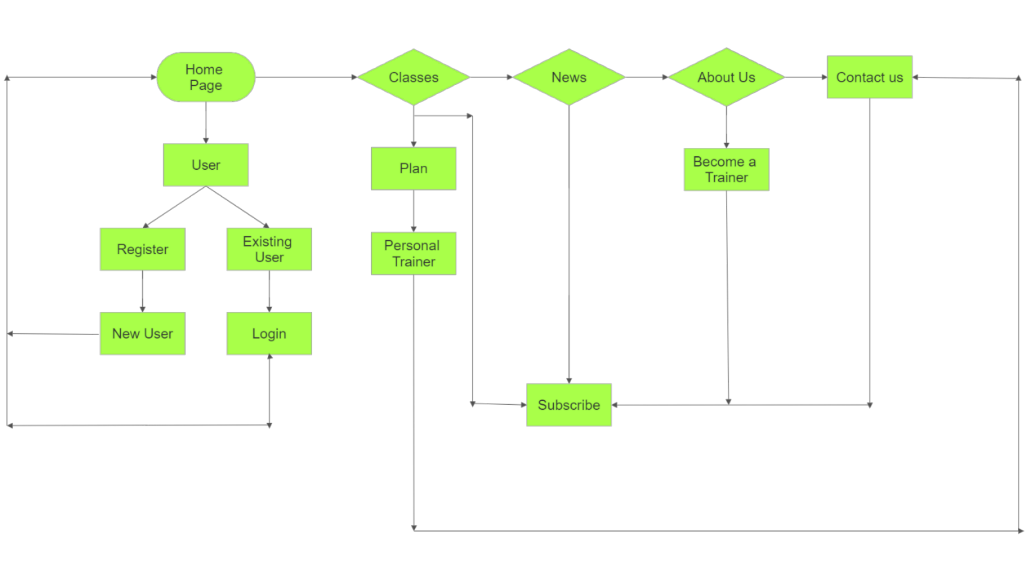
F7
FLOW CHART
About Us

Slide 9
F7
GANTT CHART
About Us
01
JANUARY
02
FEBRUARY
03
MARCH
04
APRIL
W1
W2
W3
W4
W1
W2
W3
W4
W1
W2
W3
W4
W1
W2
W3
W4
PROJECT PLAN, MOTIVATION, IDEA AND IMPLEMENTATION.
PROJECT BUILDING(SCRATCH TO RESPONSIVE FRAME
ADDING NEW FEATURES TO LIBRARY(PROJECT TOOLS)
PROJECT TESTING AND BUG FIXING
PROJECT DEPLOYMENT AND FINALISATION

Slide 10


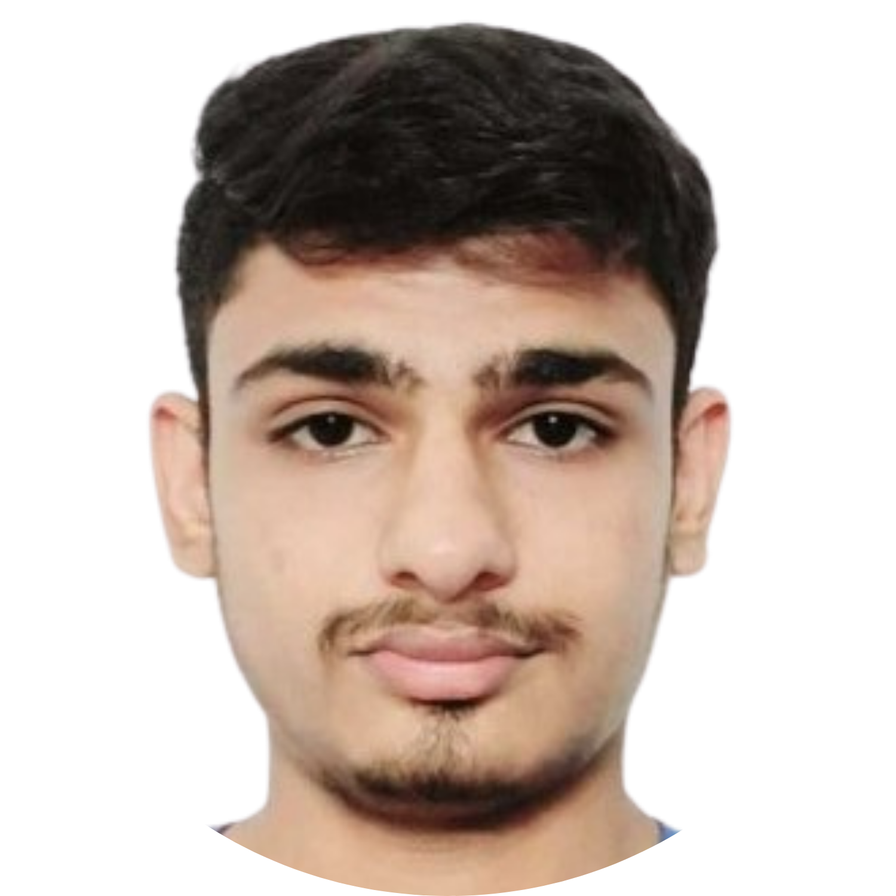
F7
TEAM PRESENTATION
About Us
YATHARTH CHAUHAN
20DCE019
KHUSHBU CHAUHAN
20DCE016
DEEP DHADUK
20DCE024

Slide 11
F7
AT THE END
About Us
THANK YOU

